Slide 1

An analysis of Healthcare Fraud using part d prescriber data
By: Sanat Lal
Data Science Capstone Project
Final Report
DATS-6501

Slide 2
INTRODUCTION
In the United States, Healthcare is important in the lives of many citizens, but unfortunately the high costs of health-related services leave many patients with limited medical care.
In response, the U.S. government has established and funded programs, such as Medicare , that provide financial assistance for qualifying people to receive needed medical services .
Unfortunately, there are individuals who commit fraud for nefarious reasons and personal gain, limiting Medicare and Medicaid’s ability to effectively provide for the healthcare needs of the elderly and other qualifying people.

Slide 3
Project Methodology & Tools used
Data Extraction & Aggregation
Data Transformation
Exploratory Data Analysis on Aggregated Data
Unsupervised Modeling: Cluster Analysis on Part D Prescriber Summary Data
Supervised Modeling : Classification on Part D Prescriber, LEIE & Open Payments Data
Model Evaluation Matrix: Model Selection
Tools Used – Python 3.7.9, Tableau, LaTex, MS Office

Slide 4
Data Extraction & Aggregation
Centers for Medicare and Medicaid Services (CMS) – PART D Prescriber Detail & Summary Data
List of Excluded Individuals and Entities (LEIE)
Open Payment Dataset (CMS)

Slide 5
Data Transformation
Cleaning
Feature modifications

Slide 6
Exploratory Data Analysis
On Aggregated and Summary Data

Slide 7
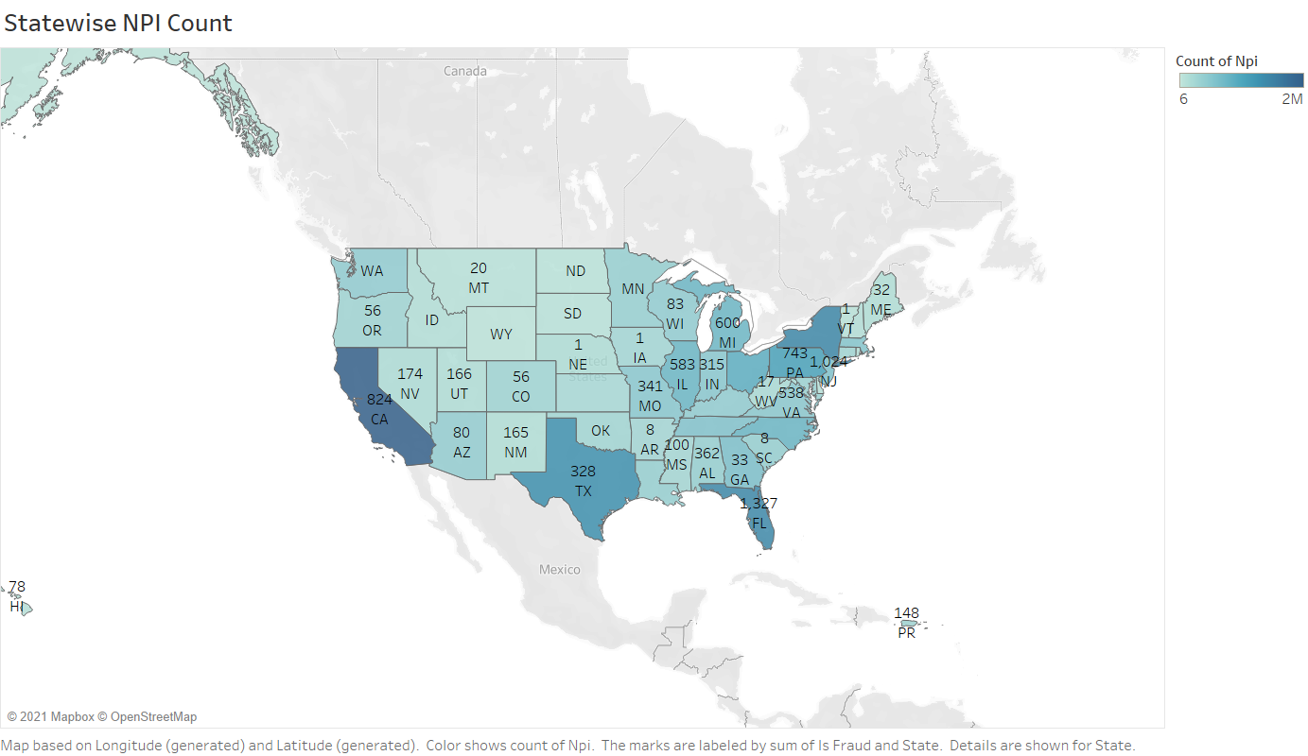
State-wise Fraud Overview

Slide 8
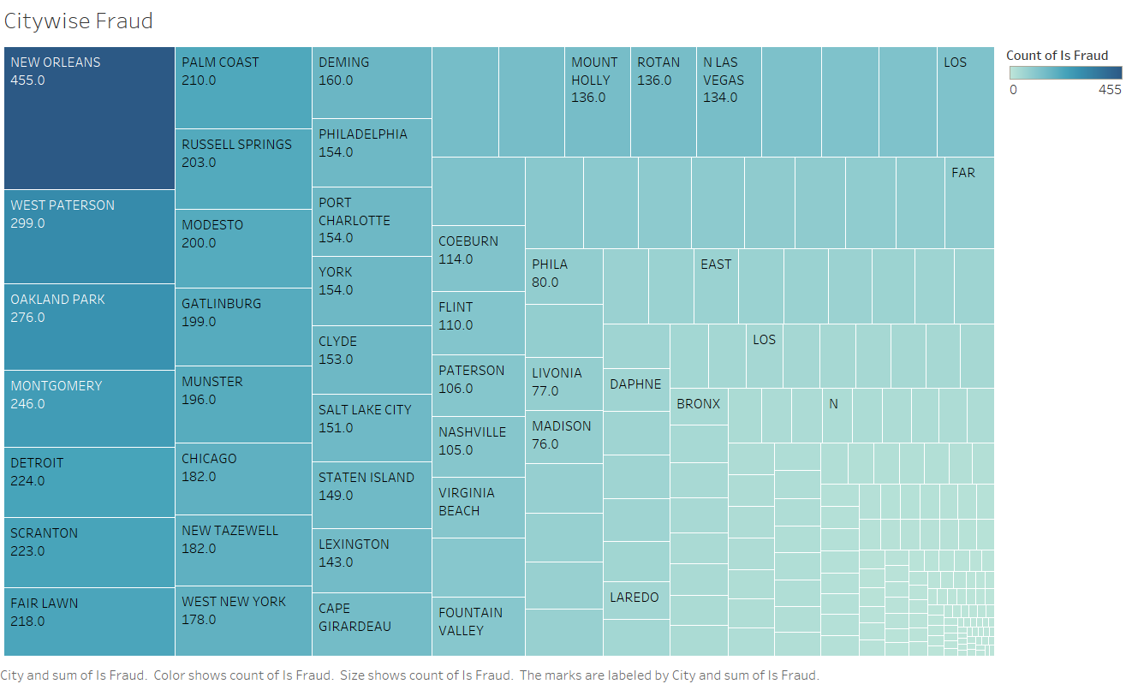
City-wise Fraud Count

Slide 9
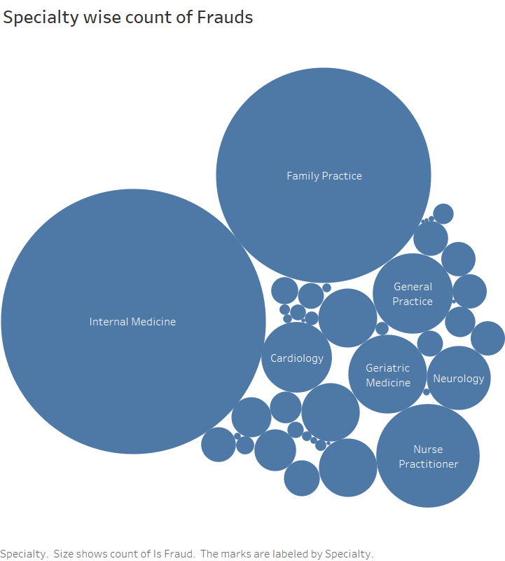
Specialty Wise Fraud Overview
Top three specialty:
Internal Medicine
Family Practice
Nurse Practitioner

Slide 10
Unsupervised Modeling:
Cluster Analysis on Part D Prescriber Summary Data

Slide 11
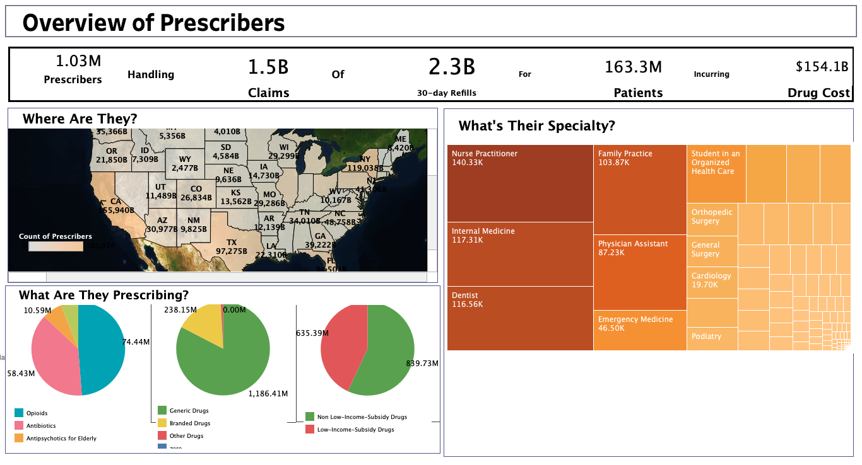
Prescription Summary Data Overview

Slide 12
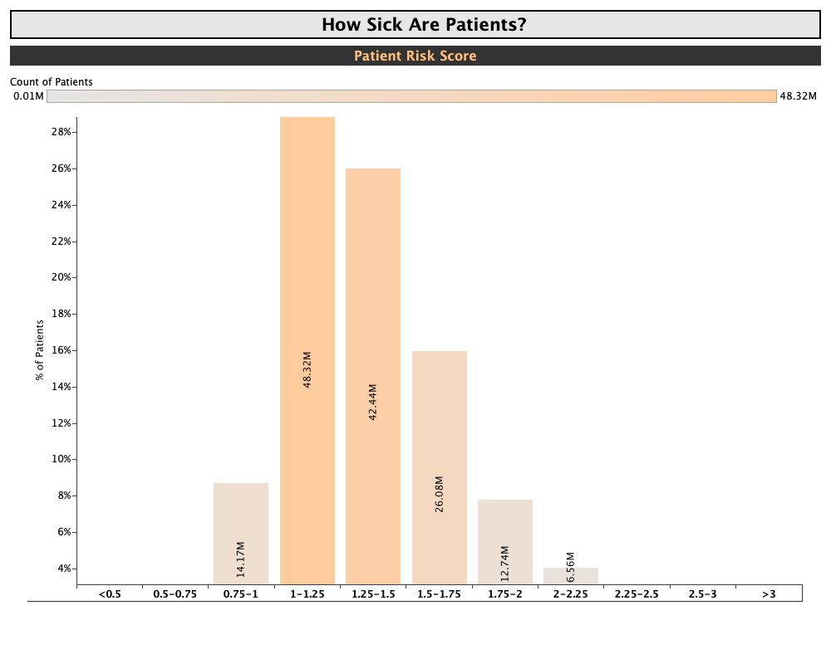
Patient Risk Score
(Calculated Field)
Most number of patients are in the category 1-1.25. i.e. ([beneficiary_average_risk_score]<1.25)
Followed by 1.25-1.5 and 1.5-1.75

Slide 13
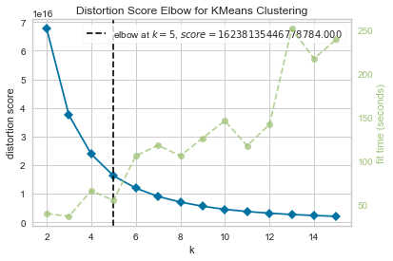
K-means Clustering

Slide 14
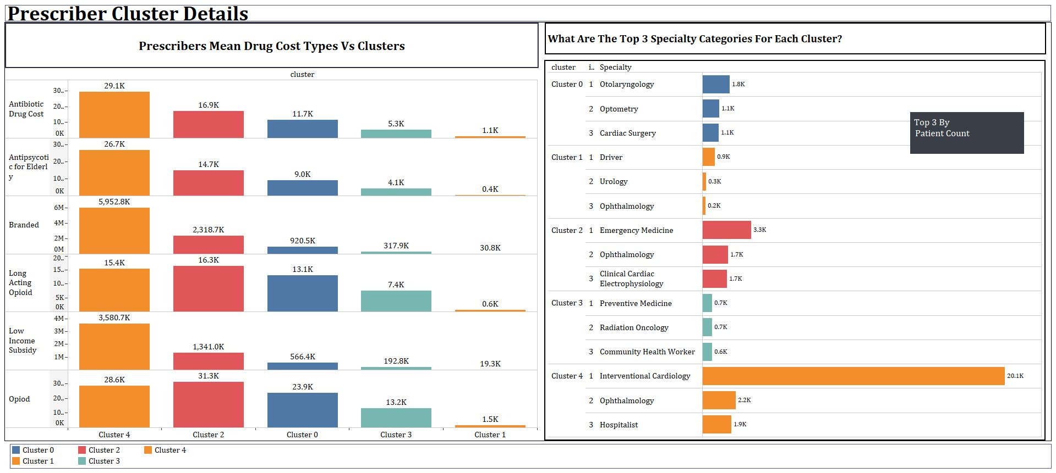
Prescriber Cluster Details

Slide 15
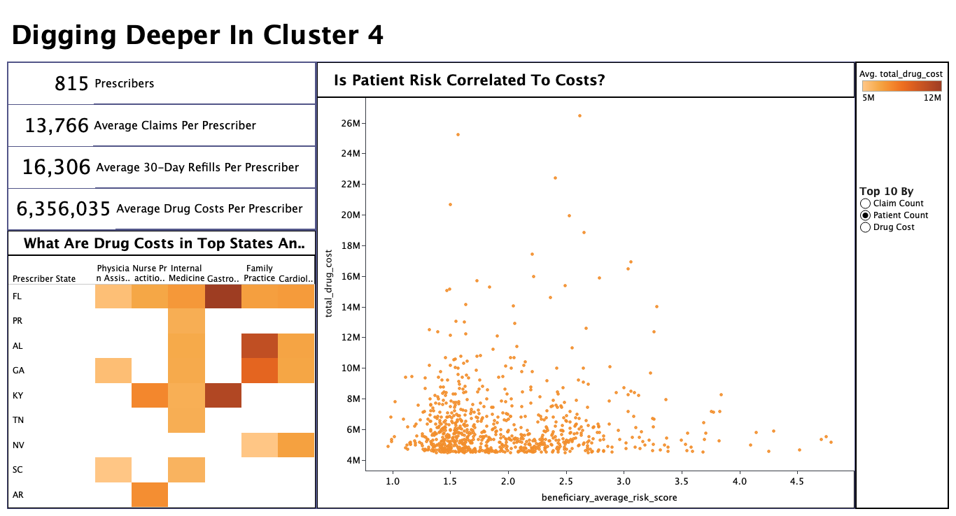
K-means Clustering: Clusters 4

Slide 16
Supervised Modeling : Classification on Part D Prescriber, LEIE & Open Payments Data

Slide 17
Model Details
Y (Response Variable) = ‘is_fraud’, X (Design Variables) = All the continuous variables with addition to calculated variables
A set of Logistic Regression, Gaussian Naive Bayes, Random Forest Classifier, and Gradient Boosting Classifier were run on the split data
Model Parameters
Logistic Regression : (C=1e5, class_weight={0: 1, 1: 2000}, n_jobs=5)
Gaussian Naïve Bayes : Default
Random Forest: (n_estimators': 500, 'max_depth': 10, 'min_samples_split': 5, 'class_weight': {0: 1, 1: 2000}, 'n_jobs’: 5)
Gradient Boosting Classifier : (n_estimators': 300, 'max_depth': 6, 'min_samples_split': 3, 'learning_rate': 0.01)

Slide 18
Evaluation Matrix
Test Matrix | Logistic Regression | Gaussian NB | Random Forest Classifier | Gradient Boosting Classifier
Brier | 0.1307 | 0.0007 | 0.0167 | 0.0006
AUC | 0.6580 | 0.6482 | 0.69 | 0.5811
Accuracy | 0.8441 | 0.9996 | 0.9974 | 0.9994
Optimal Model: Random Forest Classifier

Slide 19
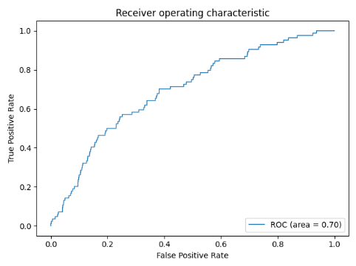
Random Forest Classifier AUC: ROC Curve

Slide 20
Key Findings -1
Florida has the highest number of frauds followed by New Jersey and California
Among the cities, New Orleans in Louisiana has the highest number of fraudulent Prescribers
While Family Practice has the highest count of Specialty counts when all the prescribers are considered, Internal medicine Specialty has the highest number of fraudulent prescribers
According to the cluster analysis on the summary table, the maximum number of patients belong to the risk score of 1-1.25 at 29.59%
Cluster 4 is significantly abnormal when patient count and drug cost is considered

Slide 21
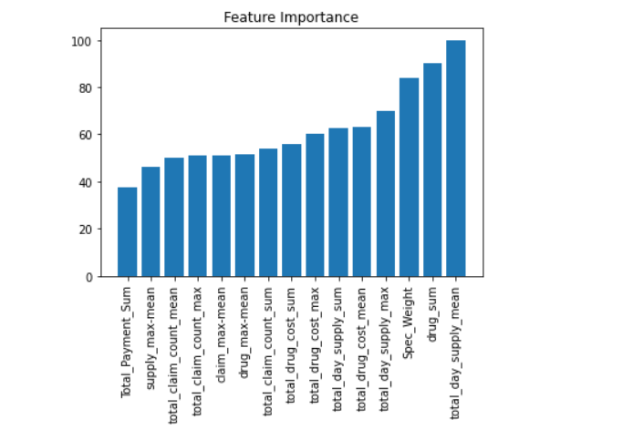
Key Findings - 2

Slide 22
Recommendations
It could be beneficial to incorporate the most frequently diagnosed disease in association with the prescribed drug
Part B data which includes calcimimetic medications under the ESRD payment system, including the intravenous medication Parsabiv, and the oral medication Sensipa can be be used as well to consider other non included drugs
A customized recurrent neural network can also help to find the most accurate model possible.
More stringent country-wide regulations, especially in Florida, New Jersey, California and Lousiana
Strict monitoring of Prescriber’s on-the-job transactions would also help to curb fraudulent activities in the medicare sector.

Slide 23
Conclusion
This project used data aggregated from CMS, EDA, and LEIE to analyze and detect healthcare fraud in Medicare Part-D for prescription drugs
It was concluded that Logistic Regression models had the most promising result and was able to classify the data as fraud with high accuracy.
With the increase in data, like any binomial classifier, the suggested logistic model should also be evaluated on basis of misclassification and precision rate.
The response variable, which is a binomial categorical variable, is easy to interpret and visualize. Finally, the suggested models can be used by the US Government and supporting groups to identify possible fraudulent claims and control the recurrence
This study can help in narrowing down the manual investigation, decreasing the efforts required to control healthcare fraud

